Slide 1
ITLG311 - Business Communication
Faculty of ICT, Mahidol University
Semester 1, 2026-27
Session 08: Information Briefings and Exam Preparation

Slide 2
Today’s Goals:
1. Business Information Briefing
2. Self and Peer Evaluation Business Information Briefing
3. Exam Content and Q&A
Now you should know…..
4. Presenting Information Exam Practice
Notes:
Course Review:
Now you should know….. (Course Outline)
Feedback
Q&A
Exam Review:
See next page

Slide 3
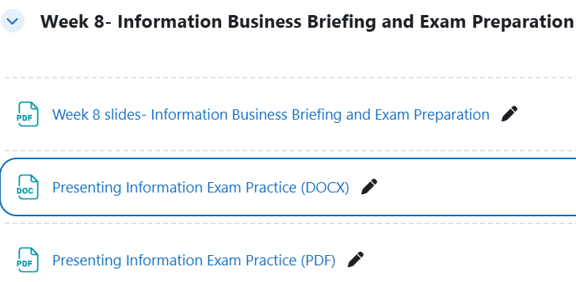
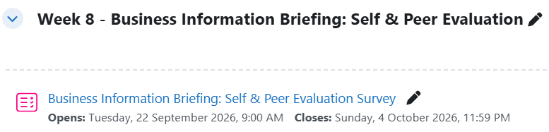
Resources

Slide 4
Business Information Briefing
Before you present:
Be ready when your group is called.
Have your presentation file ready to be opened on the classroom computer.
During the briefing
5 minutes for your briefing.
Everyone must speak.
Speak to your audience, not to the screen.
As your presentation will be recorded, please ensure you speak through the microphone to ensure the best sound quality.
Questions
Your instructor will ask questions after the briefing.
Listen carefully before answering.
Answer using the R.A.R.E Question Answering technique and use your investigation/evidence when appropriate.
GOOD LUCk!

Slide 5
Self and Peer Evaluation Business Information Briefing
Class Participation Score (10%)
5% given by your instructor based on your participation in class
5% given by your peers based on your performance and participation in the 2 group activities
Complete the Business Information Briefing: Self & Peer Evaluation in MyCourses before October 4.
All response will be kept confidential

Slide 6
The Midterm Exam:
14:00-16:00 on Friday 2nd October, 2026
Closed book exam, but English to English Paper-based dictionary is allowed
Business Communications Theory: Multiple Choice/Gap-fill/Drop-down selections
Style, Tone, Politeness, Message Length
Professional Vocabulary
Email Format/Structure
Electronic Communications (email/instant messages)
Meeting Management ((Agendas, Minutes and Meeting Vocabulary)
Reporting Figures, Tables, Charts and Results
Grammar/Vocabulary
Written Production:
Rewriting language for appropriate tone and formality
Producing appropriate business communication
Reporting and interpreting information from figures, tables and charts

Slide 7
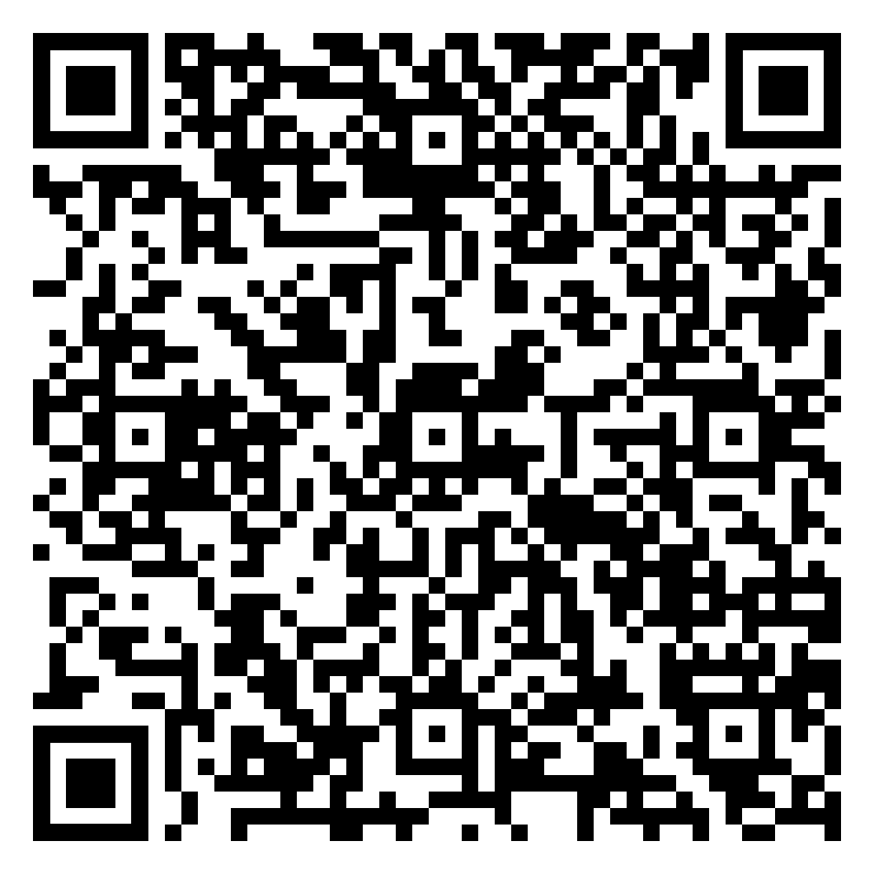
Presenting Information Exam Practice:
You will be given a figure, table or chart.
Identify the most important information, make clear comparisons, and describe the main finding.
Use relevant numbers or percentages to support your answer.
Explain what the finding suggests.

Slide 8
Congratulations on surviving the first half of the semester
THANK YOU for your participation today
Good luck in your midterm exams everyone!
See you after the exams
Until then, Take Care & Stay Safe
Finally….

